Slide 1



A Shortest Path Fınder ın Mazes Usıng A Search and Heurıstıc Optımızatıon
Introductıon to Artıfıcıal Intellıgence - Group 2

Slide 2
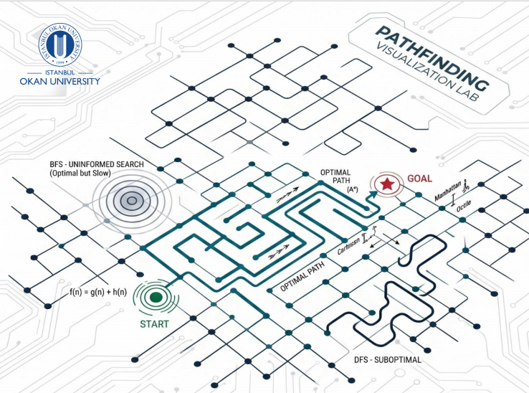

A Shortest Path FInder In Mazes Using A Search and Heuristic OptImIzatIon
Motivation: As autonomous systems become more common in robotics, autonomous vehicles, and intelligent navigation systems, efficient pathfinding has become a critical problem. Finding a valid path is no longer enough; modern systems must find the best possible path while reacting quickly to environmental changes.
Traditional uninformed search methods such as BFS and DFS become computationally expensive in large grid environments. This project focuses on improving pathfinding efficiency using the A* algorithm together with different heuristic functions.
Project Objective: The main objective of this project is to develop a shortest path finder for grid-based maze environments and compare the performance of: BFS, DFS, A* with Manhattan heuristic, A* with Euclidean heuristic, A* with Octile heuristic
The system evaluates runtime, explored nodes, path cost, and scalability while also supporting real-time visualization and dynamic obstacle replanning.
KEY CONTRIBUTIONS :
A* implementation - Heuristic comparison - Dynamic replanning - Real-time visualization - Interactive benchmarking

Slide 3
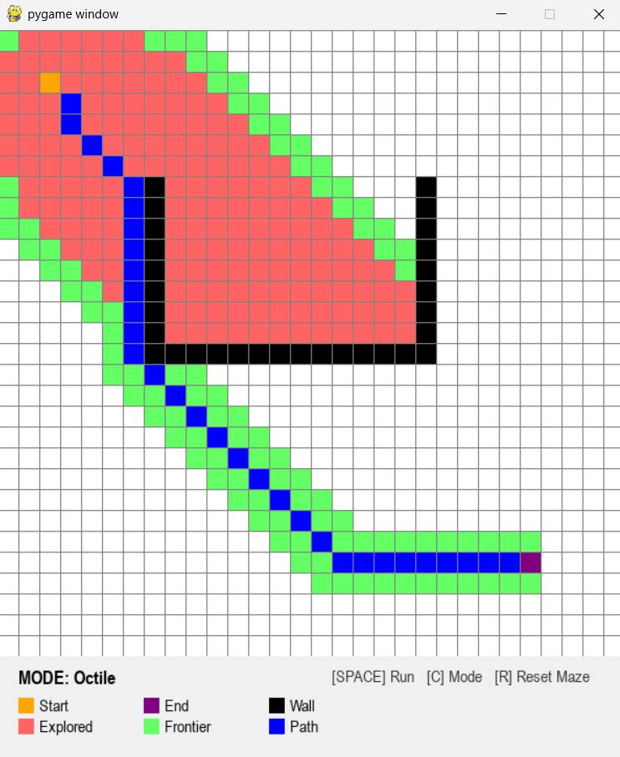
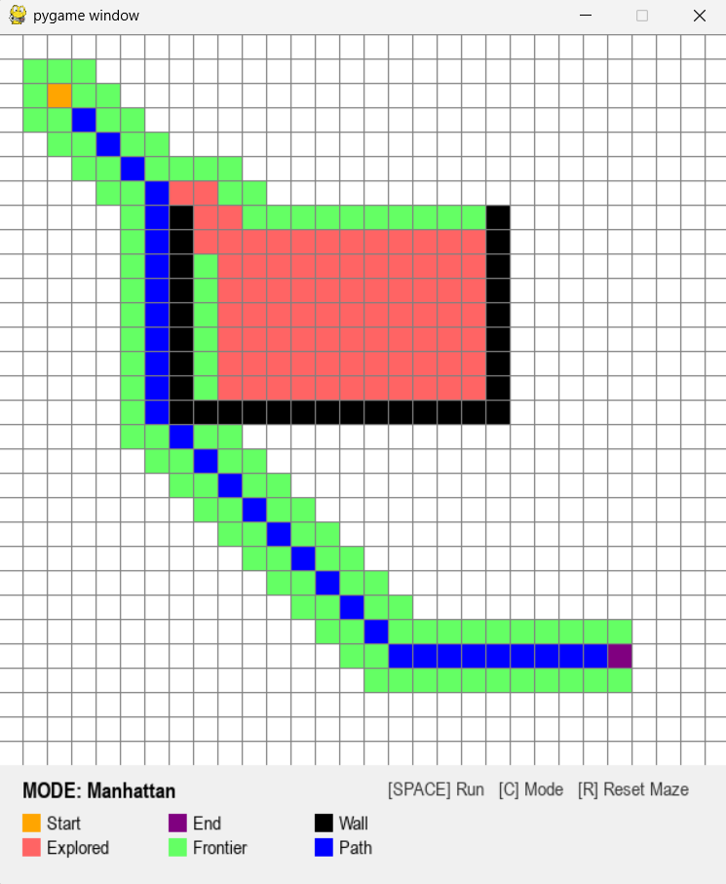
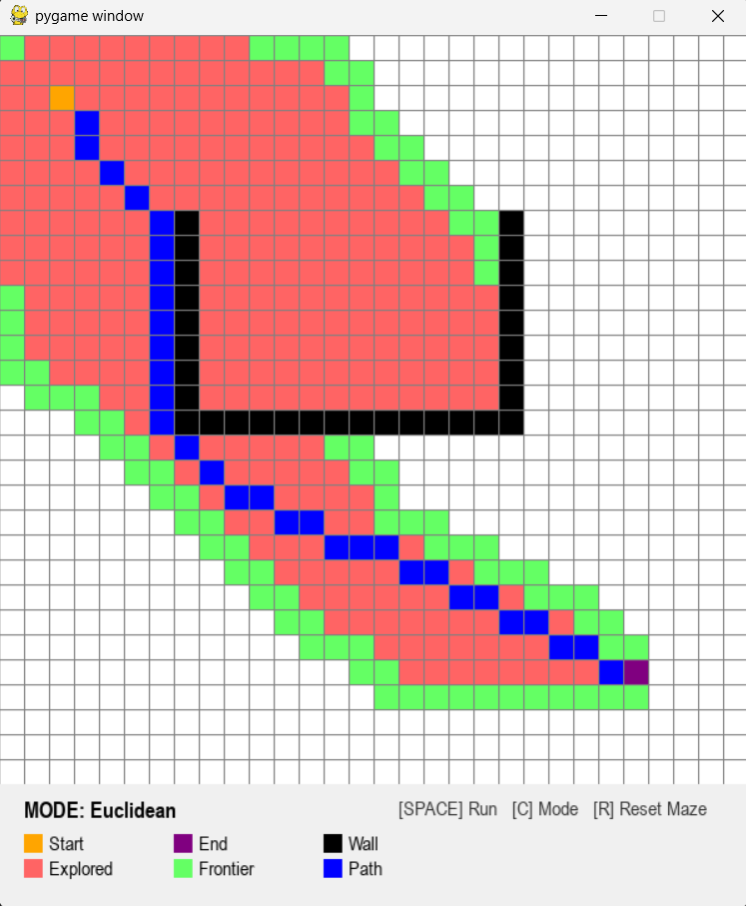
Implementatıon & Features
Implementation Features
• Interactive Pygame-based GUI for real-time visualization
• Real-time heuristic switching between Manhattan, Euclidean, and Octile modes
• Dynamic obstacle insertion and automatic path recalculation
• Live node exploration tracking and shortest path rendering
• Integrated benchmarking system for runtime and node comparison
• Interactive maze generation and reset system
Dynamic Environment Support
The system automatically recalculates the optimal route when a newly inserted obstacle blocks the current path.
Visualization Logic
• Green → Frontier nodes
• Red → Explored nodes
• Blue → Final shortest path
• Black → Obstacles-walls
• Orange → Start node
• Purple → Goal node
Generate Maze
Select Herustic
Run A*
Real-Time Benchmarking
The GUI continuously records: Runtime performance, Number of explored nodes, Path length, Path cost
This allows direct comparison between different heuristic strategies under the same maze conditions.
Explore Nodes
Find Optimal Path
Visualize Results

Slide 4
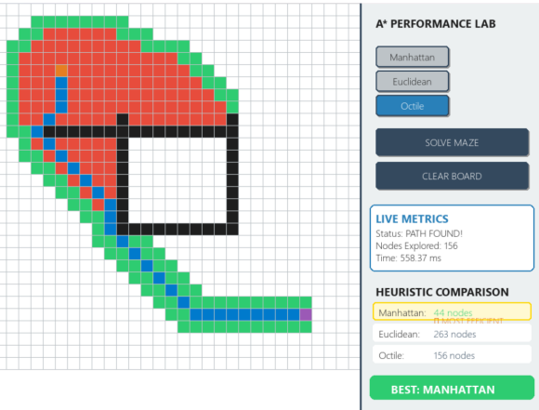
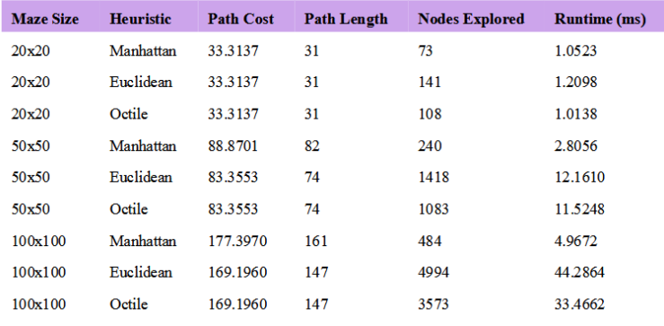
METHODOLOGY AND DATA
Methodology and System Design
Development Environment: The project was implemented in: Python, NumPy, Pygame, heapq / deque structures.
Core Algorithm: The main search logic is based on the A* algorithm:
f(n)=g(n)+h(n)
Where: g(n) represents the movement cost from the start node, h(n) represents the heuristic estimation to the goal.
Heuristic Functions Compared
Manhattan Distance: Best suited for 4-directional movement.
Euclidean Distance: Uses straight-line distance estimation.
Octile Distance: Designed specifically for 8-directional movement and diagonal traversal.
Data & Experimental Setup
Randomly generated grid mazes
Obstacle density: 25%
Maze sizes: 20×20, 50×50, 100×100
Performance metrics: Runtime, explored nodes, path cost, path length. The system also supports real-time obstacle insertion and automatic path recalculation.

Slide 5
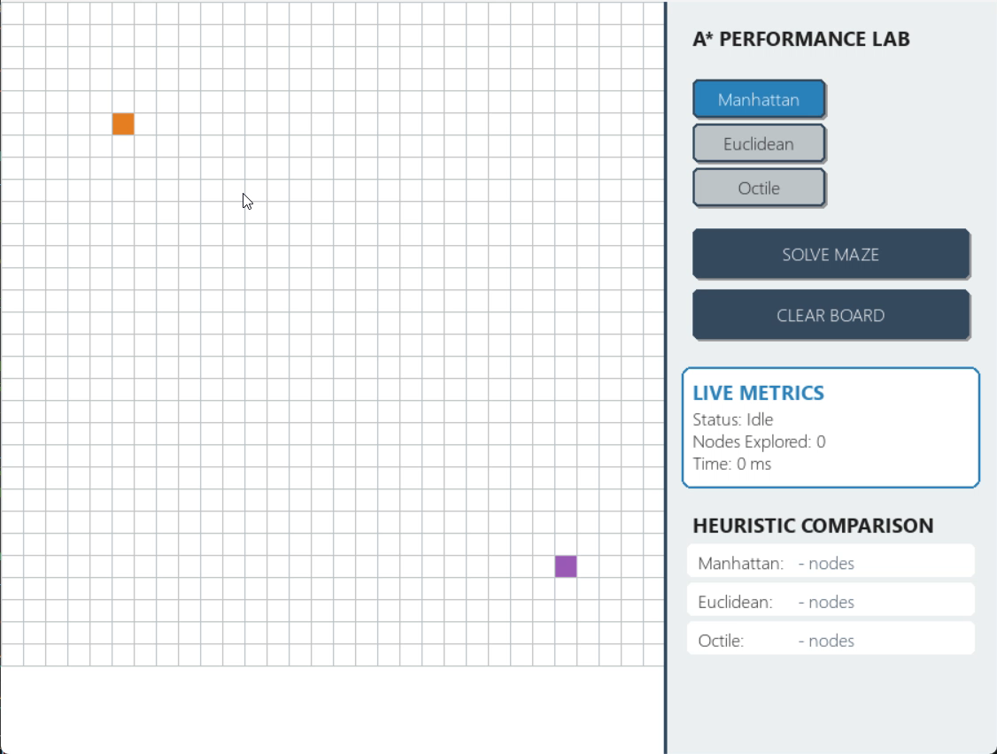
Video Demonstration

Slide 6
ConclusIon & Future Work
Conclusion
Future Work
The A* algorithm significantly outperformed classical uninformed search methods such as BFS and DFS in large and complex maze environments.
Experimental results showed that heuristic selection directly affects runtime, node exploration, and path quality.
Manhattan heuristic performed faster in some structured maze layouts, but it sometimes generated less optimal paths because it ignores diagonal movement.
Euclidean heuristic produced optimal paths, although it explored a larger number of nodes and required higher computational cost in larger mazes.
Octile heuristic achieved the best overall balance between efficiency and optimality for 8-directional grid environments.
The integration of real-time visualization, live metrics, and dynamic replanning transformed the project from a theoretical algorithm implementation into an interactive AI engineering system.
Integration of advanced replanning algorithms such as D* Lite and LPA*
Multi-agent pathfinding and collision avoidance systems
Real-time autonomous robot and drone navigation applications
GPU-based optimization for larger-scale dynamic environments
Adaptive heuristic systems that automatically change according to maze density
More advanced benchmarking under realistic autonomous navigation scenarios
Final Insight
The effectiveness of A* depends not only on the algorithm itself, but also on how well the heuristic matches the structure of the environment.

